Slide 1
Determine frequency
Frequency (Hz)
Stimulus drive (nA)
The boxed area is where the wave either converge or diverse, causing the period changes, which is not the desired performance.
Solution: find peaks of wave and used standard deviation to see if it’s converge or diverse.

Slide 2
Determine frequency
FLX for [0 5.23]
FLX for [0.3 0.734]
EXT for [0 5.23]
EXT for [0.3 0.734]
Give the proper stimulus to initiate the oscillation, then stop the input. Gw = 0 goes to stationary.
Give a excitatory stimulus as disturb, the phase plane is shift and change of frequency is not the same.
0.743
3.5
5.23
If we want a desired frequency, say 1.5 Hz. The possible solutions are [Gw D] = [0 5.23]; [0.1 3.5]; [0.3 0.734]. However, the performance for different conductance is not the same. The phase plane size are smaller with large conductance.
Problems: h-nullcline range seems not right ; working on the V-nullcline.
Notes:
1: 0-1.5s
2: 2-4s 2nA

Slide 3
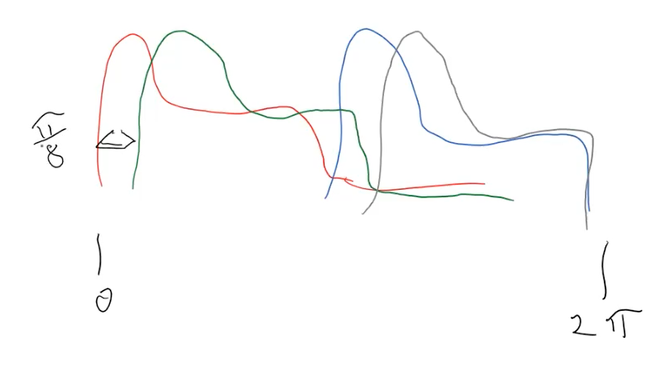


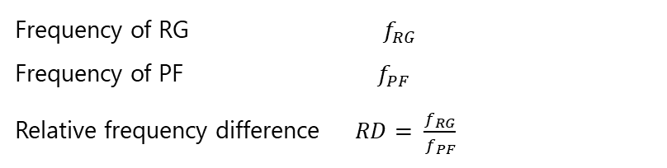

Analysis of the phase delay
When the pattern formation and rhythm generator frequency equals (or close), but the timing is not.
$$f=1.6813 hz$$
6.25%
10.3%
$$f=1.6813 hz$$
Frequency of RG $f_{RG}$
Frequency of PF $f_{PF}$
Relative frequency difference $RD= \frac{f_{RG}}{f_{PF}}$
When the $RD <5\%$ we consider it’s frequency equal.
When frequency equal, we count every cycle start of RG and PF then take the mean of it’s difference as mean phase shift, then divide it by RG frequency we get the phase delay percentage.

Slide 4
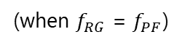
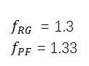
Phase Shift
In last meeting, I wrongfully handle the definition of frequency lock. So I change who I calculate the phase shift. But when I search for frequency equal for RG and PF I found the discontinuity.
PD = 2.64%
PS = 19.85%
$f_{RG}$ = 1.3
$f_{PF}$ = 1.33
(when $f_{RG}$ = $f_{PF}$)
Solution: Prolong the simulation time and chop off the initiate state to get the steady frequency.
Solution: Compare peak numbers to get rid of the double peak region.

Slide 5
Phase Shift
Situation 1: When the general rhythm frequency is set, how much flexibility will the PF have? (How much phase shift will the pattern formation generate when reacts to stimulus/feedback/perturbation to the PF layer?)
Phase shift percent
Conductance (uS)
Normalized conductance
Normalized input
Normalized input
Notes:
D1 = 3; F = 1.2987

Slide 6
Phase Shift
Situation 2: When the general rhythm is changed, how much flexibility will the PF have? (How much phase shift will the pattern formation generate when reacts to stimulus/feedback/perturbation in RG layer?)
Conductance (uS)
Phase shift percent
Normalized conductance
Normalized input
Normalized input
Notes:
D2 = 4;

Slide 7
Phase Shift
Situation 3: How stimulus/feedback/perturbation will resulting phase shift in a designed two-layer CPG?)
C = 1
C = 0.1

Slide 9
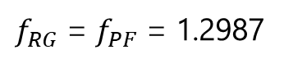
Phase Plane
FLX for RG
FLX for PF
EXT for RG
EXT for PF
D1 = 3; C = 0.1; D2 = 4;
Give PF a 2 nA stimulus for a short period of time.
Give RG a 2 nA stimulus for a short period of time.
$f_{RG}$ = $f_{PF}$ = 1.2987
RG frequency keeps 1.298, PF speed up during the perturbation, but recovers after stimulus ends.
PF speed up with RG during perturbation, and keep the same frequency for this case.

